Slide 1
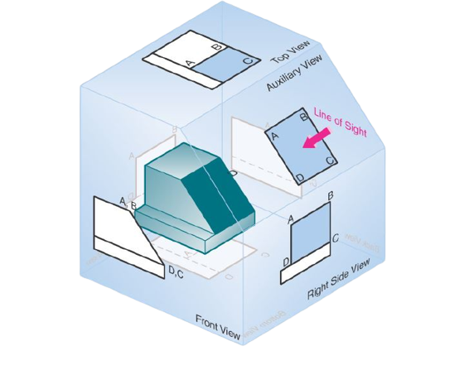
Multi-view Orthographic Drawings
Prepared by:
Er. Bibek Magar
BE in Automobile Engineering
IOE, Thapathali Campus
bibek.magar@thc.tu.edu.np

Slide 2
Introduction
Before constructing a new machine, the designer has to imagine the shapes of the various parts of the machine and their positions relative to each other. The designer has to then convey the complete description of the shape and size of each part to the manufacturing division for fabrication. This description is conveyed through the orthographic projections of various parts.
Machine parts can be described in two or more views depending upon the shape of the object. As studied in the chapter on projections of solids, such projections can be made for any possible position of the object.
Actual machine parts are generally created by additions and subtractions of simple elementary solid shapes. Subtractions are in the form of holes, slots or grooves, and their orthographic projections are also similar to those of the corresponding solids.
Hence, the projections of machine parts are the combinations of projections of such elementary simple solid shapes, as explained in the next section. Some machine parts are block-type and are bounded by plane surfaces. The projections of such parts are then the combinations of the projections of those surfaces.

Slide 3
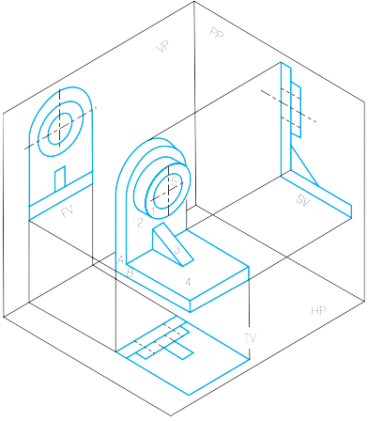

Slide 4
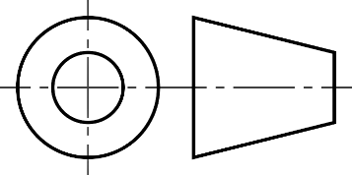
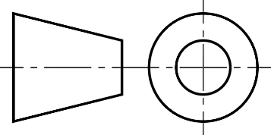
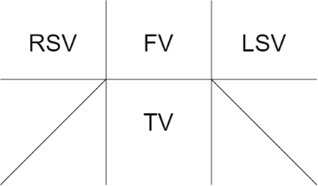
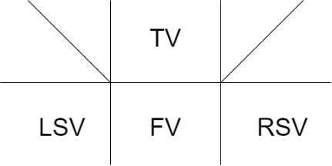
Angles of Projection
SN | 1st Angle Projection | 3rd Angle Projection
1 | When the object is placed at the 1st quadrant | When the object is placed at the 3rd quadrant
2 | The object is situated between the observer and the plane of projection | The plane is situated between the observer and the plane of projection
3
4

Slide 5
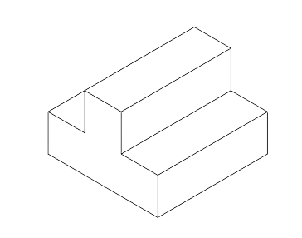
Let’s study the layout of these projections with the help of a simple solid object given below
Top View
10
Left Side View (Obscured)
30
30
Right Side View
Front View

Slide 6
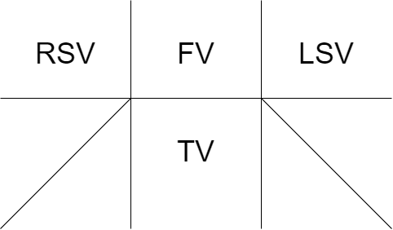
1st Angle Projection Layout:

Slide 7
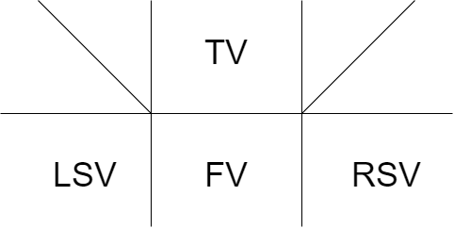
3rd Angle Projection Layout:

Slide 8
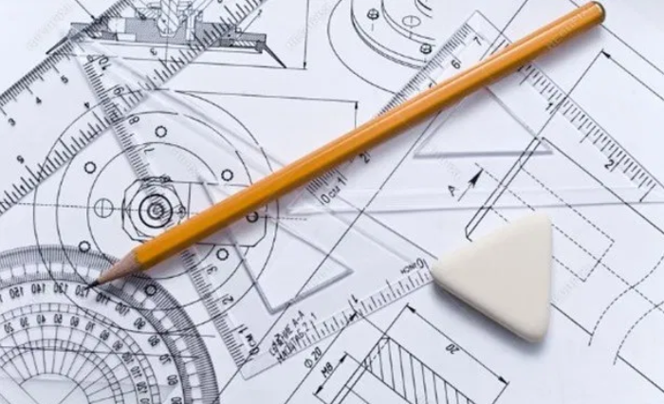
Solved Examples:

Slide 9
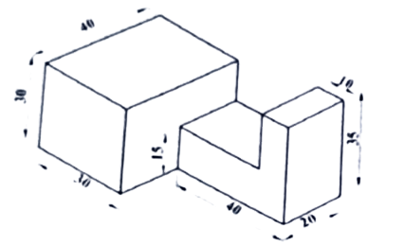
1) Translate the given solid object into 3 view orthographic drawing.

Slide 11
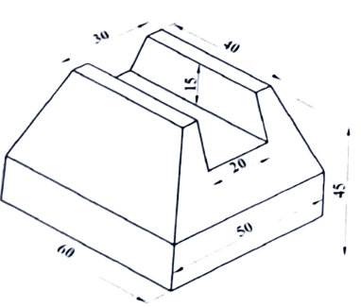
2) Translate the given solid object into 3 view orthographic drawing.
15

Slide 13
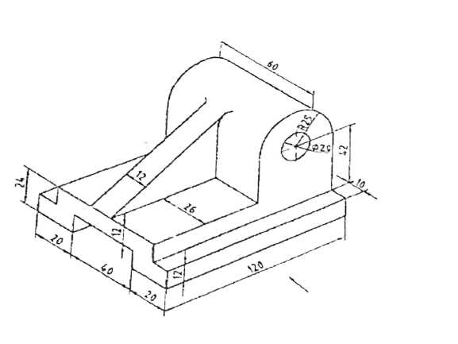
3) Translate the given solid object into 3 view orthographic drawing.

Slide 14
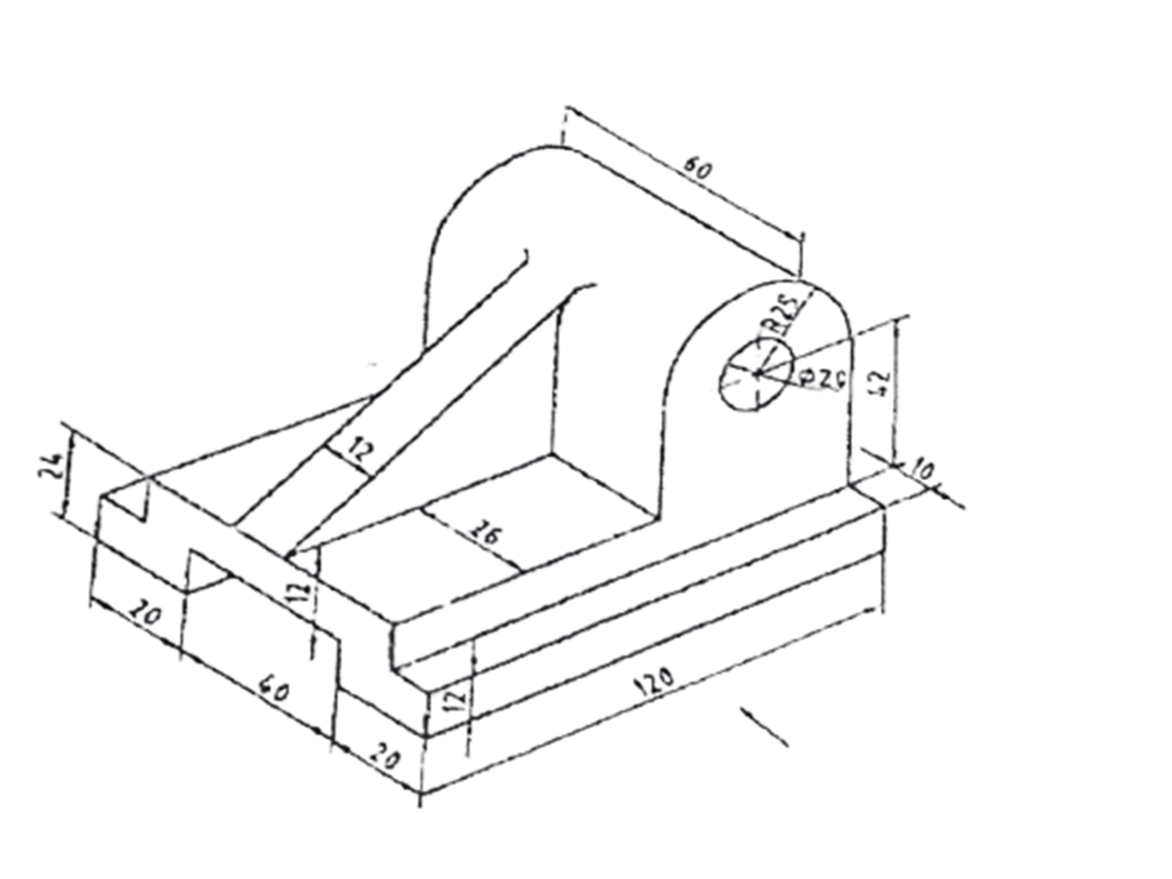

Slide 15
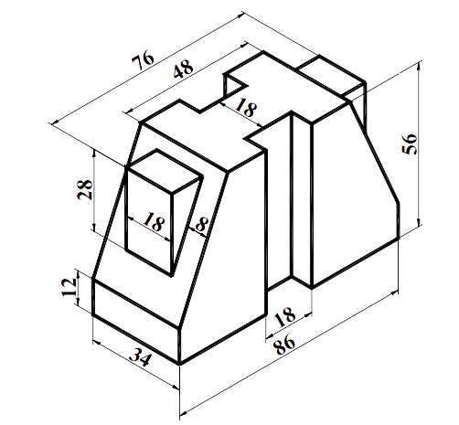
4) Translate the given solid object into 3 view orthographic drawing.

Slide 17
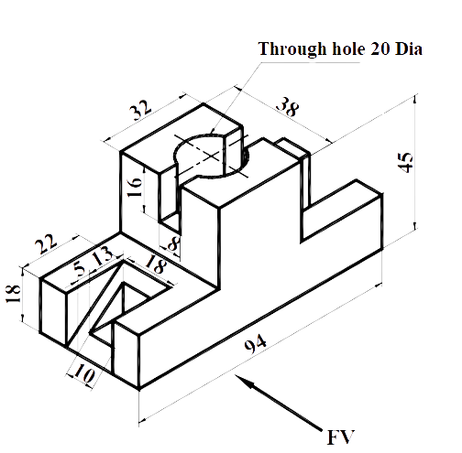
5) Translate the given solid object into 3 view orthographic drawing.

Slide 18
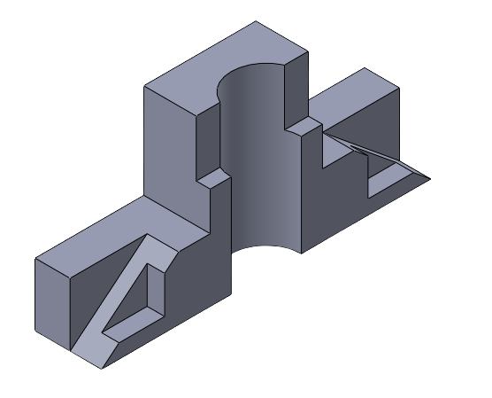
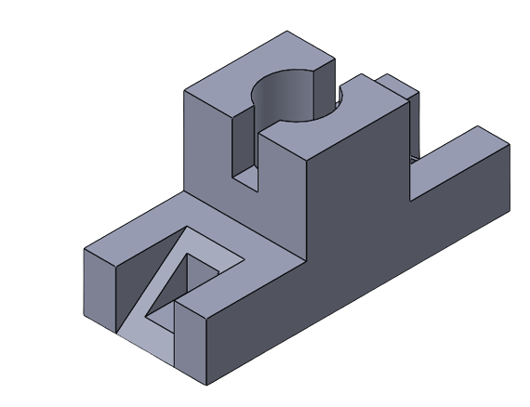

Slide 20
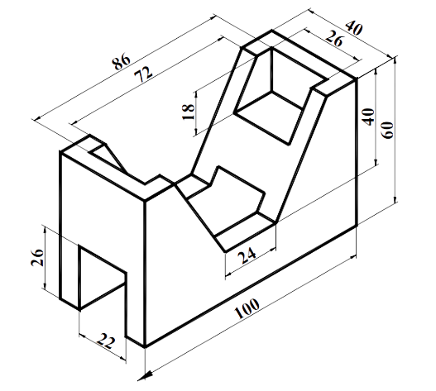
6) Translate the given solid object into 3 view orthographic drawing.

Slide 21
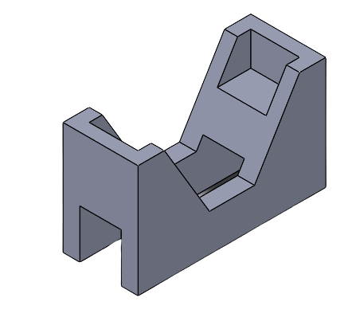
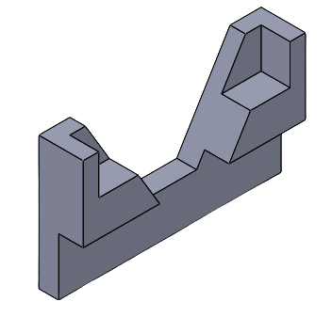

Slide 23
Sectional Views
Machine parts have external as well as internal details. The internal features are not visible in an exterior view and if they are to be shown in the drawing they are required to be drawn by short dashed hidden lines. If there are many such details represented by hidden lines, the description becomes confusing as the lines of one detail overlap with those of other details.
To avoid this confusion, the objects are assumed to have been cut through at important points and the sectional views are drawn so that these internal features can be shown by outlines.
For machine parts to be manufactured, the complete information about each and every detail—whether it is of the internal or the external portion of the machine part—is required to be given in the drawing. Sectional views, therefore, are unavoidable in industrial drawings.
In this chapter, the discussion is limited to full- and half-sectional views along with the revolved, removed, partial, and off set sections.

Slide 24
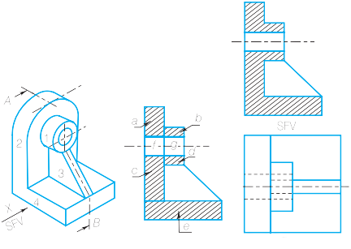
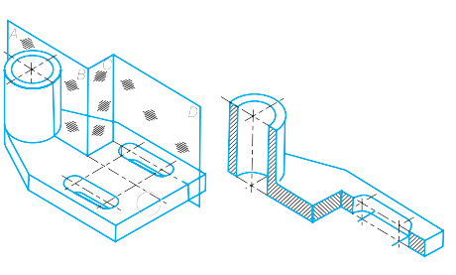
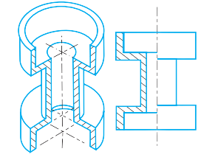
Types of Sectional Views
Full-Sectional View
Half-Sectional View
Offset Sectional View
Revolved Sectional View
Removed Sectional View
Partial Sectional View

Slide 25
Solved Examples:

Slide 26
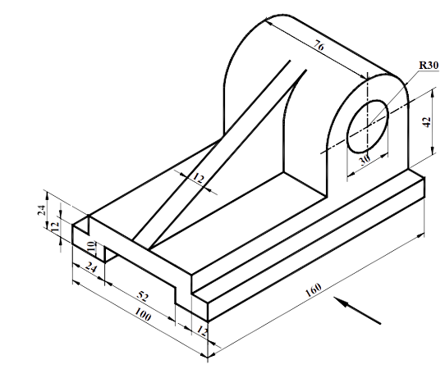
7) Translate the given solid object into 3 view orthographic drawing with a sectional front view.

Slide 27
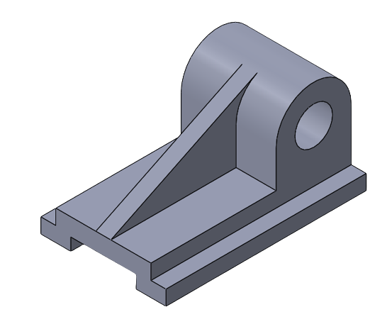
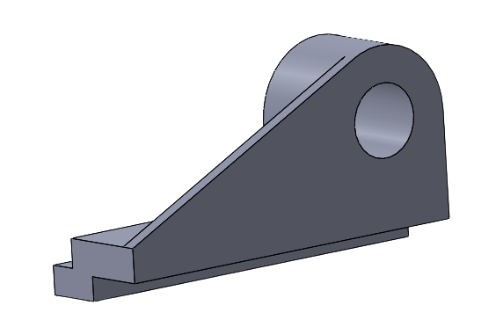

Slide 30
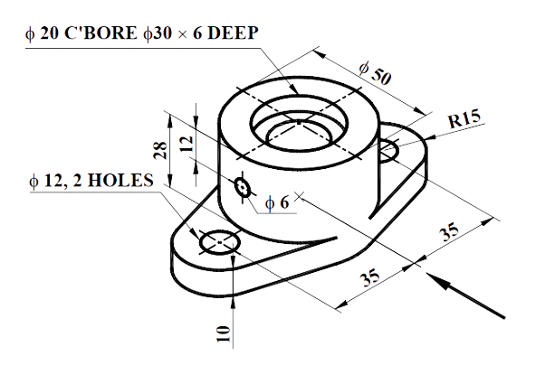
8) Translate the given solid object into 3 view orthographic drawing with a half sectional front view and side view.

Slide 31
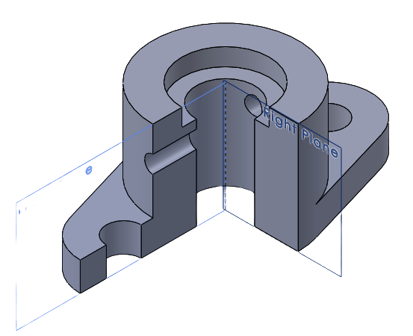
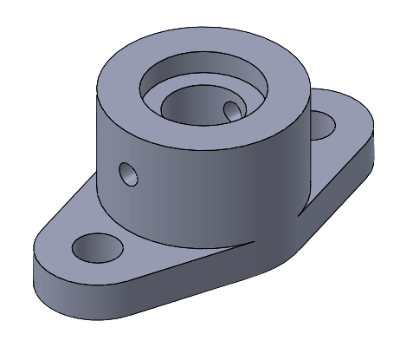

Slide 34
Auxiliary Views
Sometimes we require auxiliary views in order to draw the orthographic views.
It occurs when one of the face of object is inclined with one of the principal planes.

Slide 35
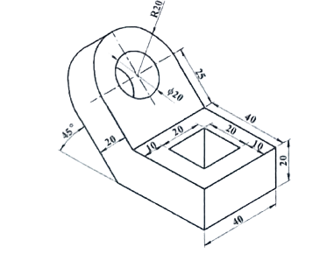
9) Draw the front view, top view, and auxiliary top view of the inclined part of the pictorial view given below.

Slide 36
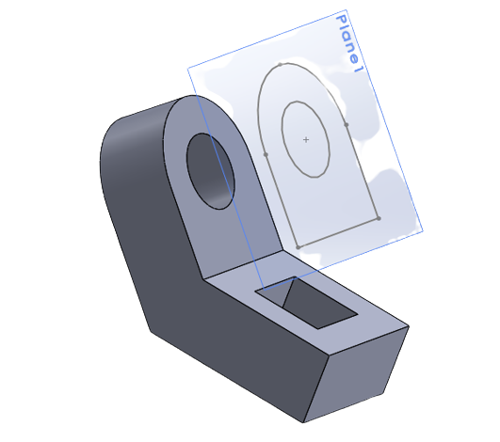
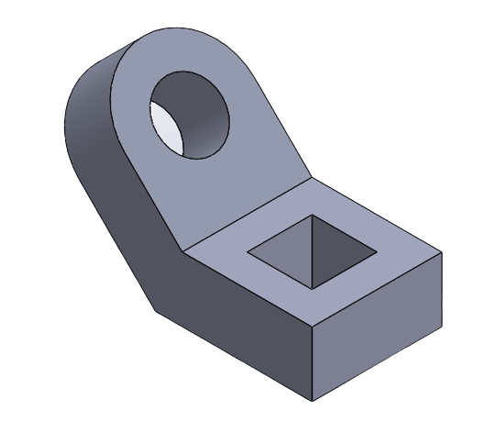

Slide 37
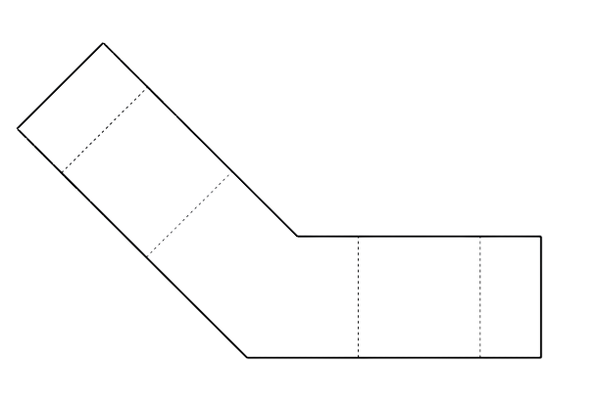
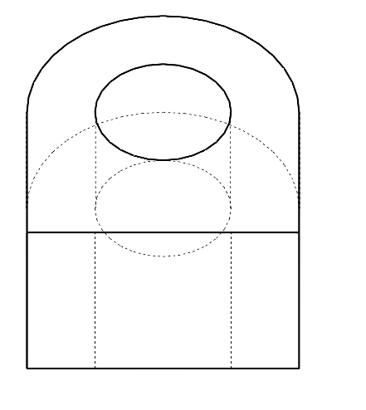
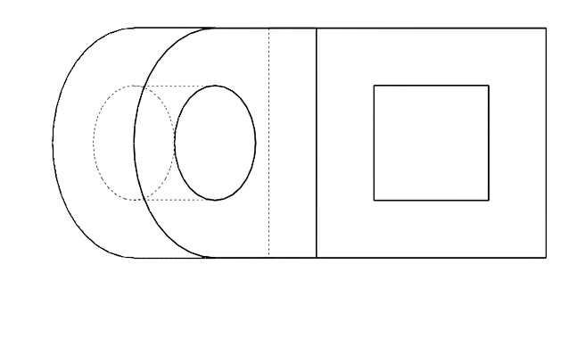

Slide 39
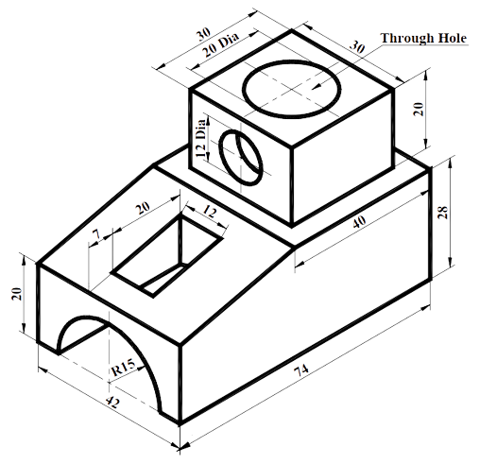
10) Draw the sectional front view, top view, and side view of the pictorial view given below.

Slide 40
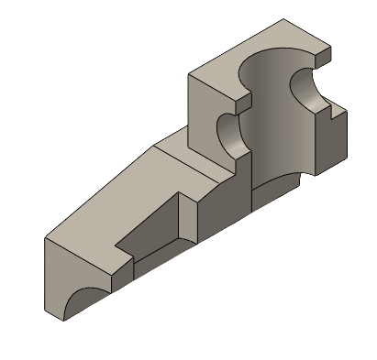
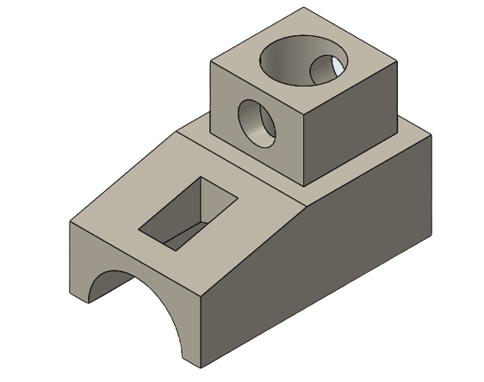

Slide 42
